Slide 1


Count Function in SQL
Fundamentals and Background

Slide 2
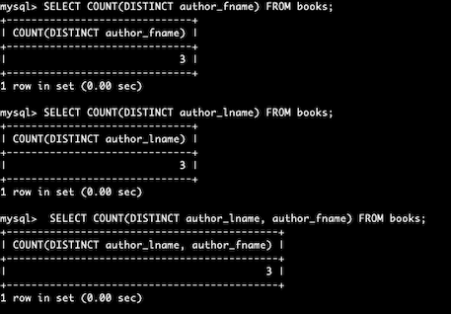
Count Functions
count returns the number of rows that match the specific statement or number of occurrences of a substring. The syntax is:
select count (<column name>) from <table name>
where <condition>;
For example:
Notes:
count returns the number of rows that match the specific statement or number of occurrences of a substring. The syntax is: select count (<column name>) from <table name> where <condition>;

Slide 3
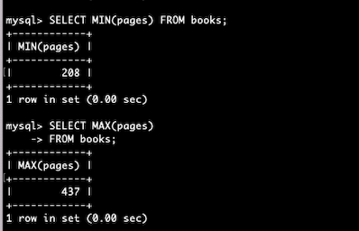
Count Functions (count.)
min/max returns the lowest and highest values of a column. The syntax is:
select min or max (<column name>) from <table name>
where <condition>;
For example:
Notes:
min/max returns the lowest and highest values of a column. The syntax is: select min or max (<column name>) from <table name> where <condition>;

Slide 4
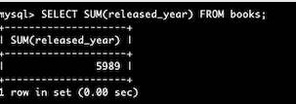
Count Functions (count.)
sum calculates the sum of distinct values. The syntax is:
select sum (<column name>) from <table name>
where <condition>;
For example:
Notes:
sum calculates the sum of distinct values. The syntax is: select sum (<column name>) from <table name> where <condition>;

Slide 5
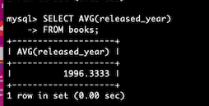
Count Functions (count.)
avg find the average of a field in a various record. The syntax is:
select avg (<column name>) from <table name>
where <condition>;
For example:
Notes:
avg find the average of a field in a various record. The syntax is: select avg (<column name>) from <table name> where <condition>;

Slide 6
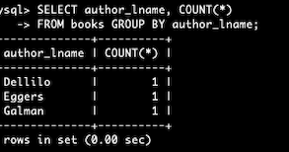
Count Functions (count.)
group by groups rows with the same values. The syntax is:
select (<column name>) from <table name>
where <condition> group by (<column name>);
For example:
Notes:
group by groups rows with the same values. The syntax is: select (<column name>) from <table name> where <condition> group by (<column name>);

